Slide 1
DATA SCIENCE My Vivino Project
Communication and Presentation Part
Siroj Sukhrobov

Slide 2
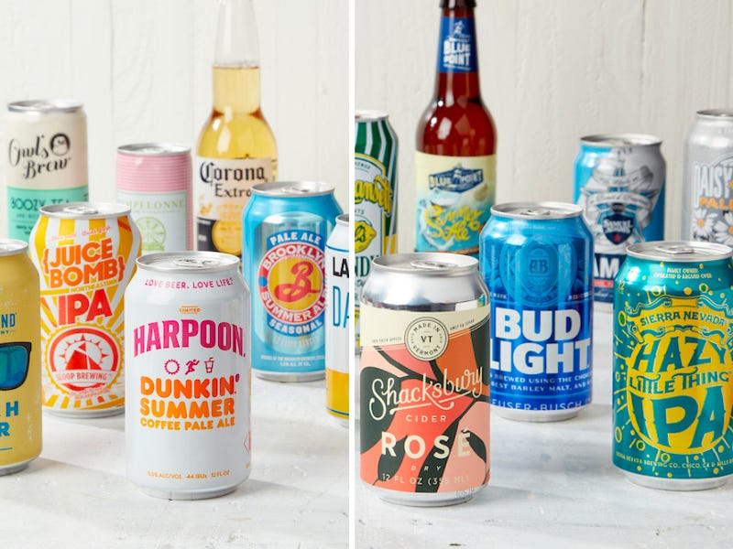
I chose the online beer store as the theme of the project https://www.beeradvocate.com/.
In the presentation, I will briefly and clearly consider the whole picture of this product.

Slide 3
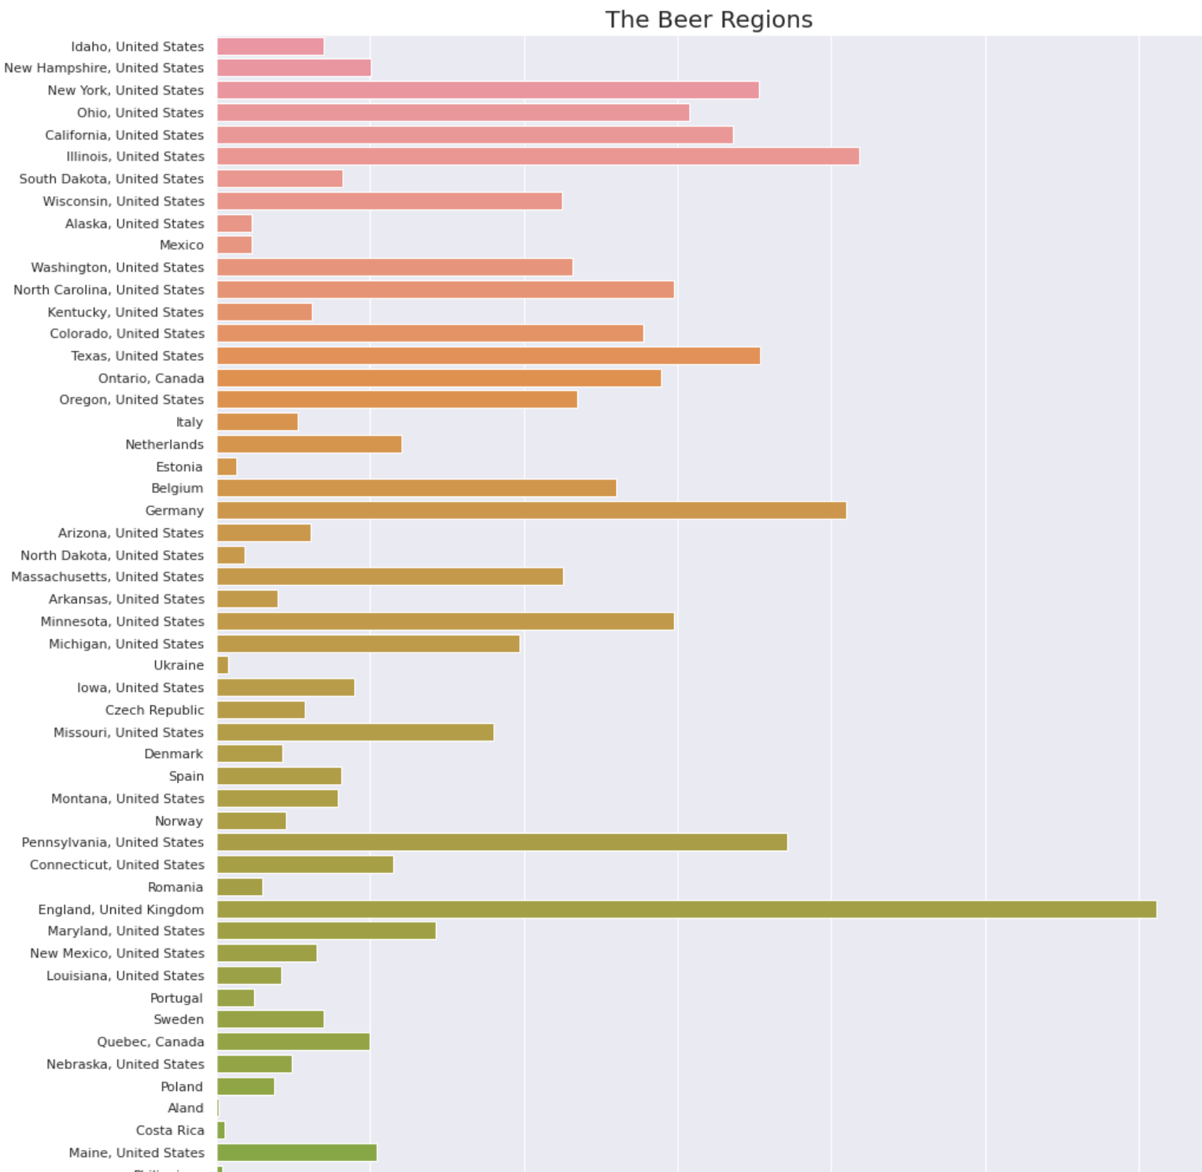
BEER REGIONS
Let's start from where the beer is made. The graph shows that most of the beer is provided from England, followed by Germany and the state of Illinois. The smallest quantity is made in Costa Rica and Ukraine.
03

Slide 4
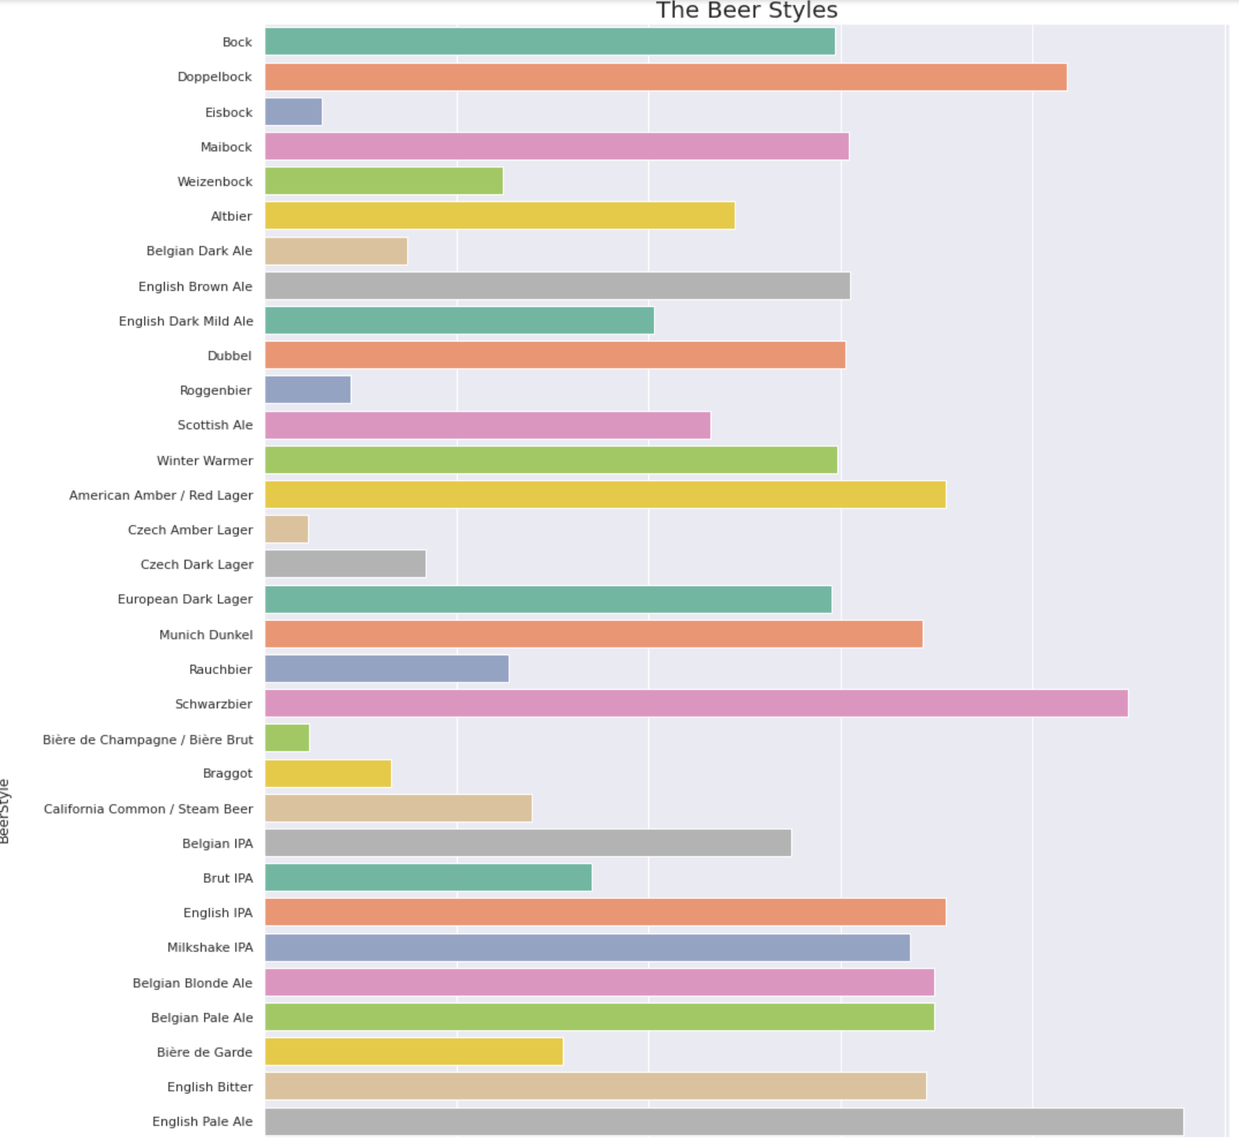

BEER STYLES
Now let's move on to beer styles. Here you can clearly see that styles English Pale Ale, Schwarzbier, Dopplebock make up the bulk of beer. And the smallest styles Biere Brut, Czech Amber Lager, Eisbock.

Slide 5
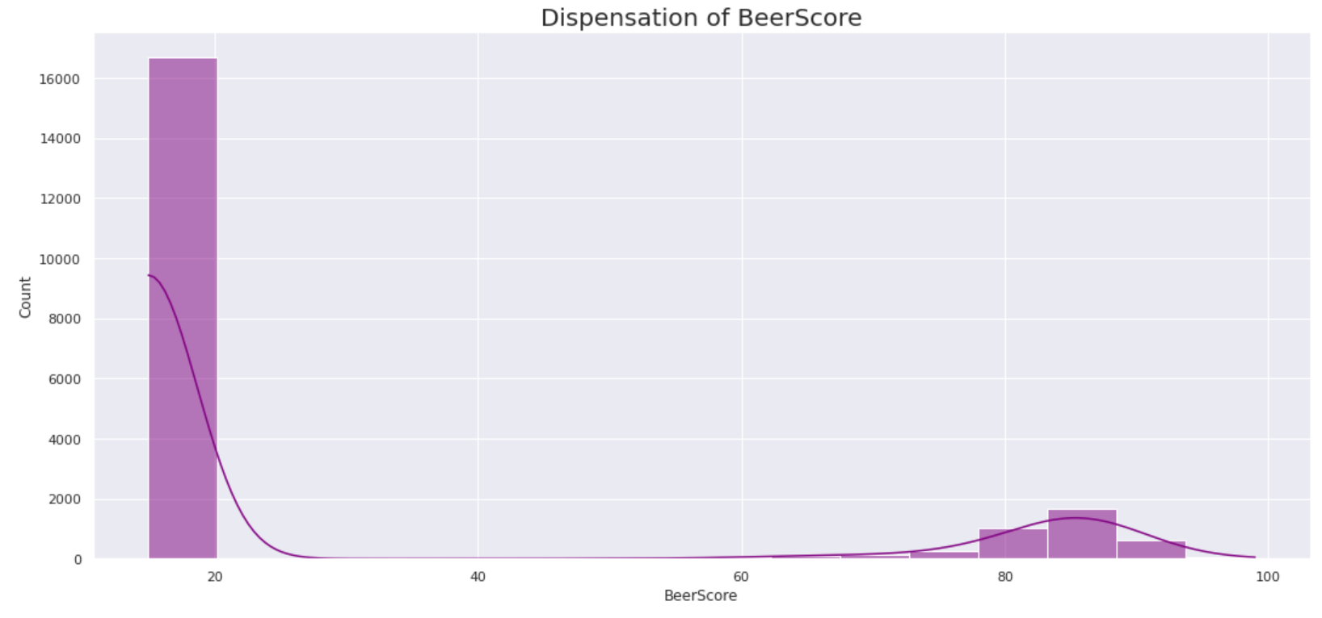
Dispensation of Beer Score
The graph shows that most of the beers score less than 20, the rest of the beers have scores ranging from 80 to almost a 100.

Slide 6
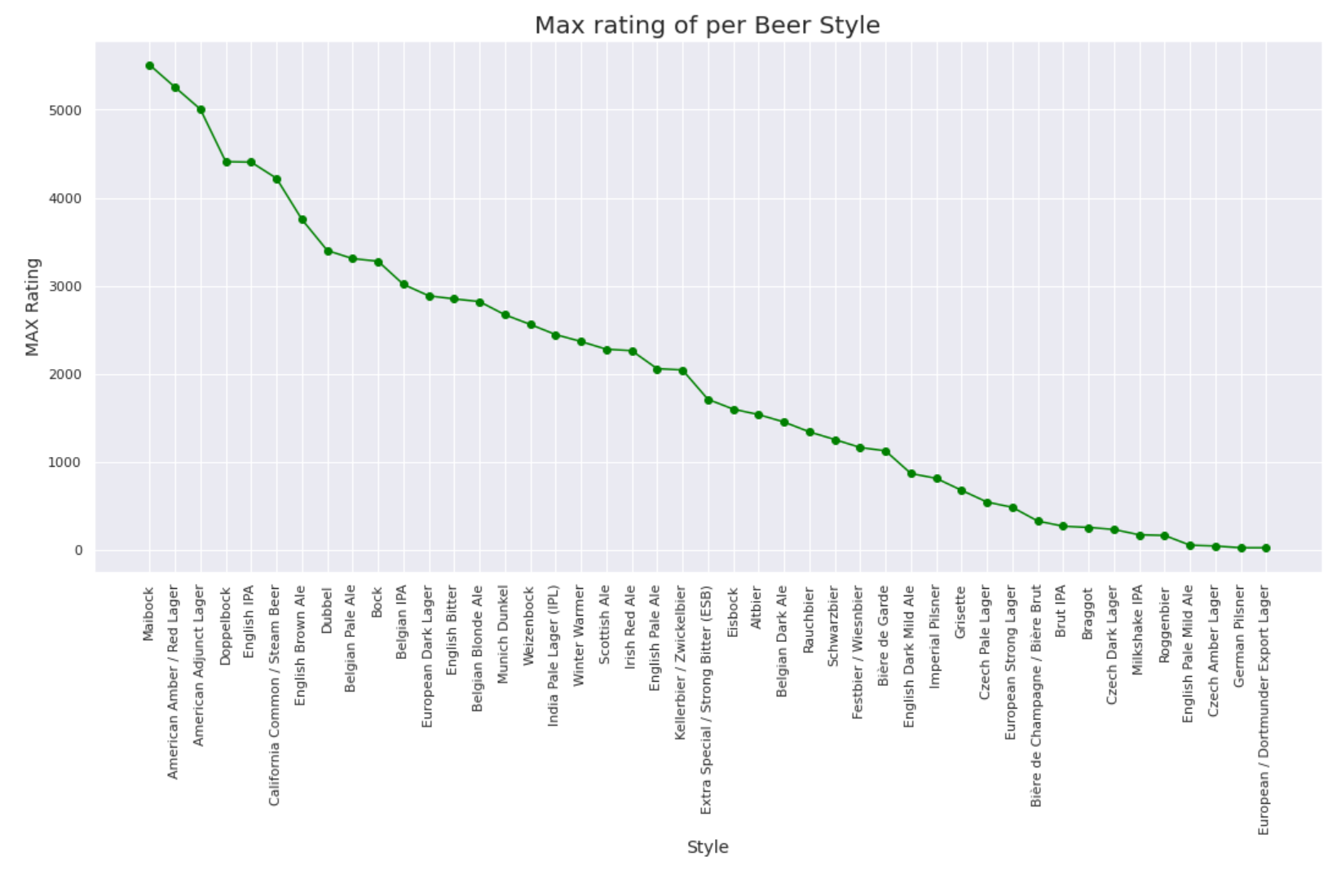
Max rating of per Beer Style
As for the maximum beer style rating, the picture is as follows: Maibock, American Amber and Dopplebock have the most ratings, and European Export Lager, German Pilsner have the smallest ratings.

Slide 7
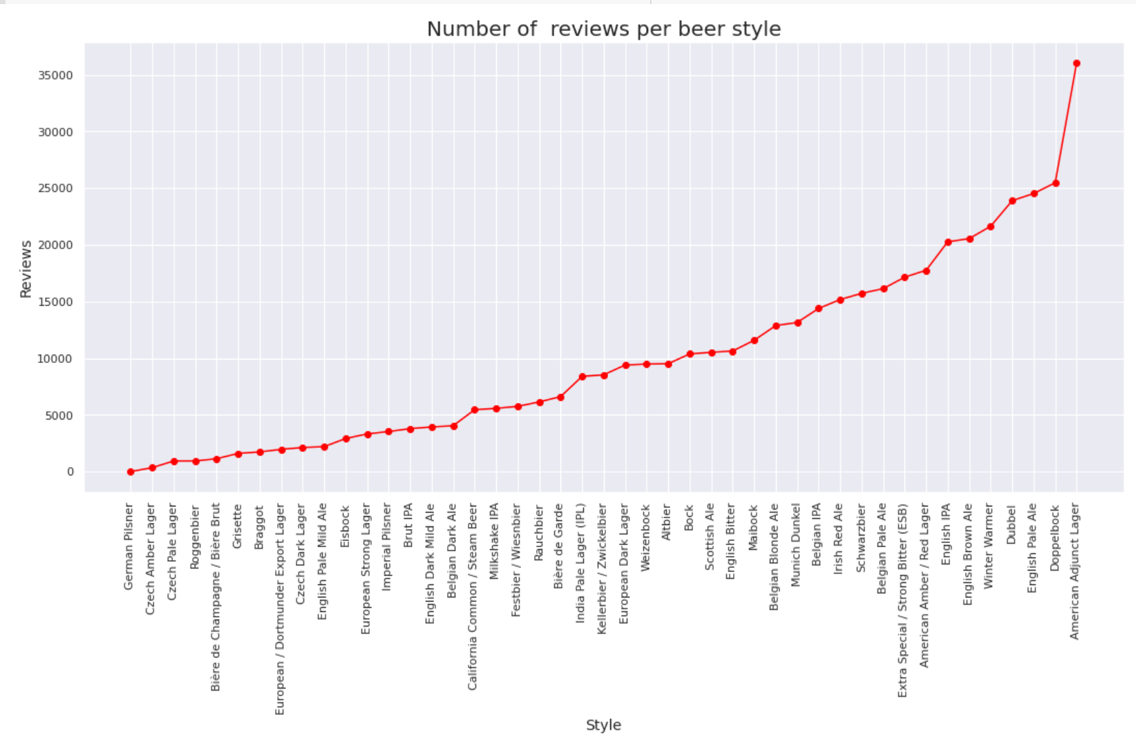
Number of reviews per beer Style
In addition to the above, I can add a little enlightenment to the number of views of each style of beer. It can be seen that American Adjust Lager, Dopplebock, English Pale Ale have the most reviews, and German Pilsner, Czech Amber Lager the least.

Slide 8
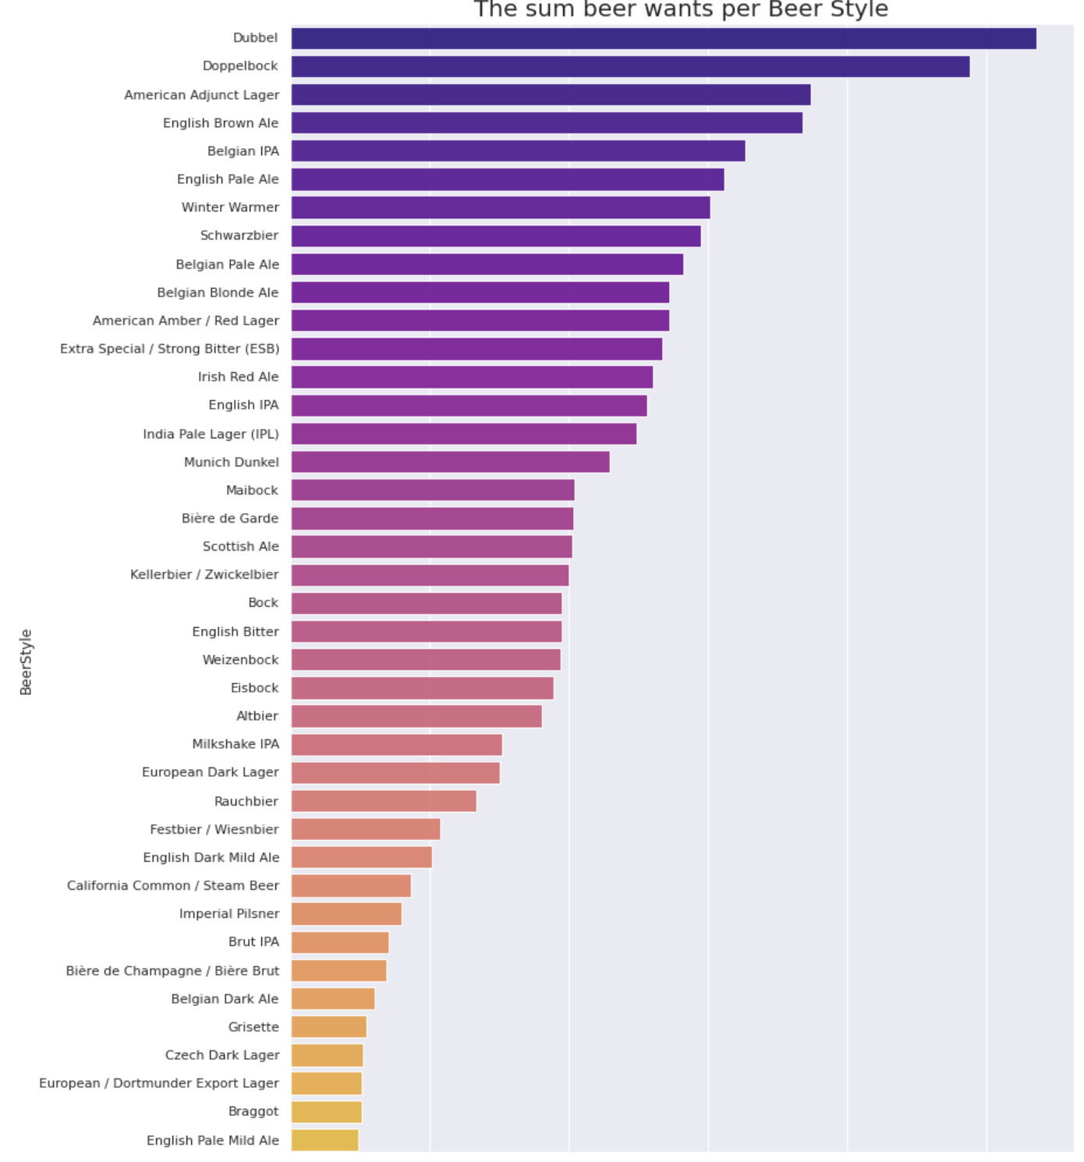
The sum of beer wants per Style
In this graph, you can see that the most people want Duppel, DoppleBock, American Adjunct Lager styles of beer. And least of all they prefer the beer styles English Pale Mild Ale, Braggot.

Slide 9
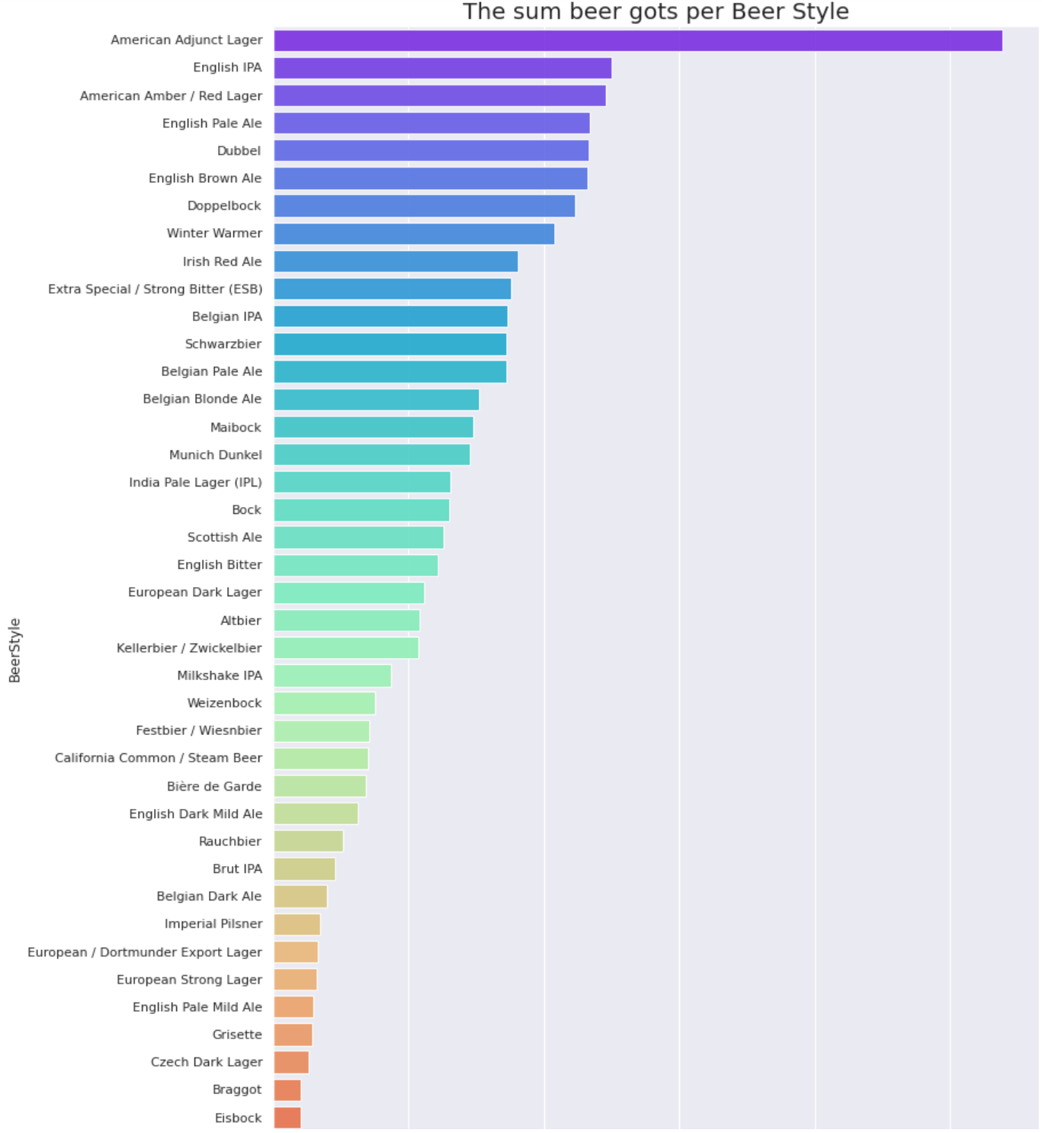
The sum of beer gots per Beer Style
The graph showing how many people got a certain style of beer is not that different from the graph above. Here, too, almost the same picture, most people prefer American Lager and English IPA, the least people got Eisbock, Braggot

Slide 10
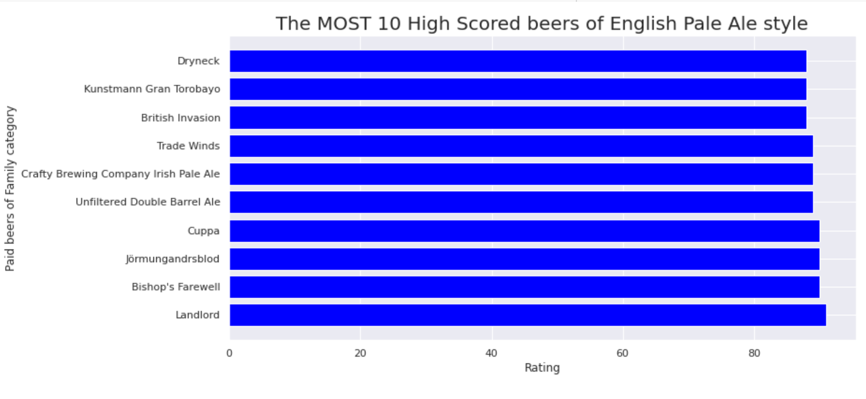
The Most 10 High Scored beers of English Pale Ale
In the end, I want to briefly review the most common style of English Pale Ale beer. Here you can see the top 10 highly rated beers of this style.

Slide 11
Thank you for attention!!! ☺☺

